Slide 1
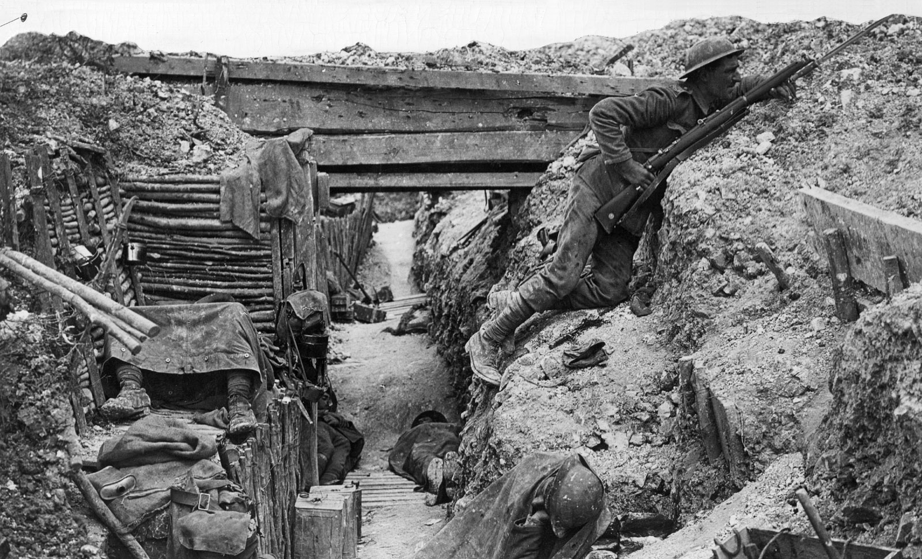
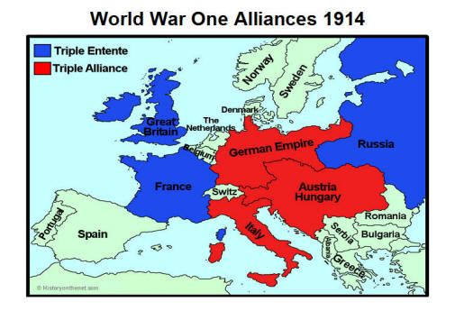
Aftermath of World War I
Introduction into European History

Slide 2
BACKGROUND INFO: WORLD WAR 1
Opening: What do you remember learning about World War I?
Brainpop: World War 1

Slide 3
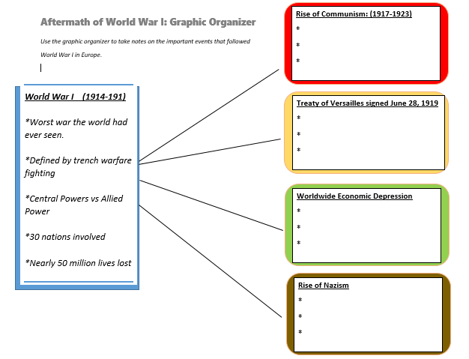
Your assignment
for today’s live class. ----→
Use the PowerPoint
to complete your graphic organizer in Verge.

Slide 4
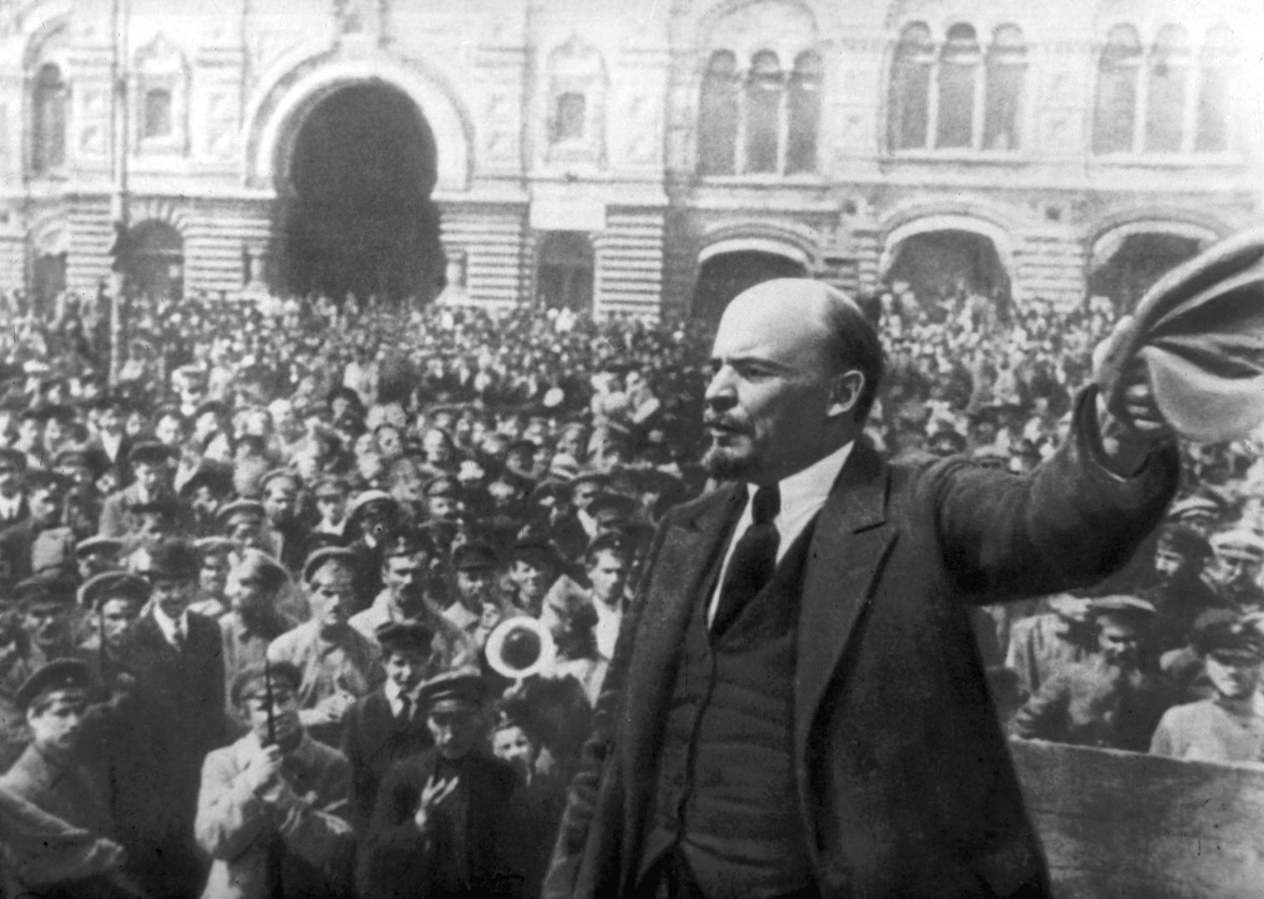
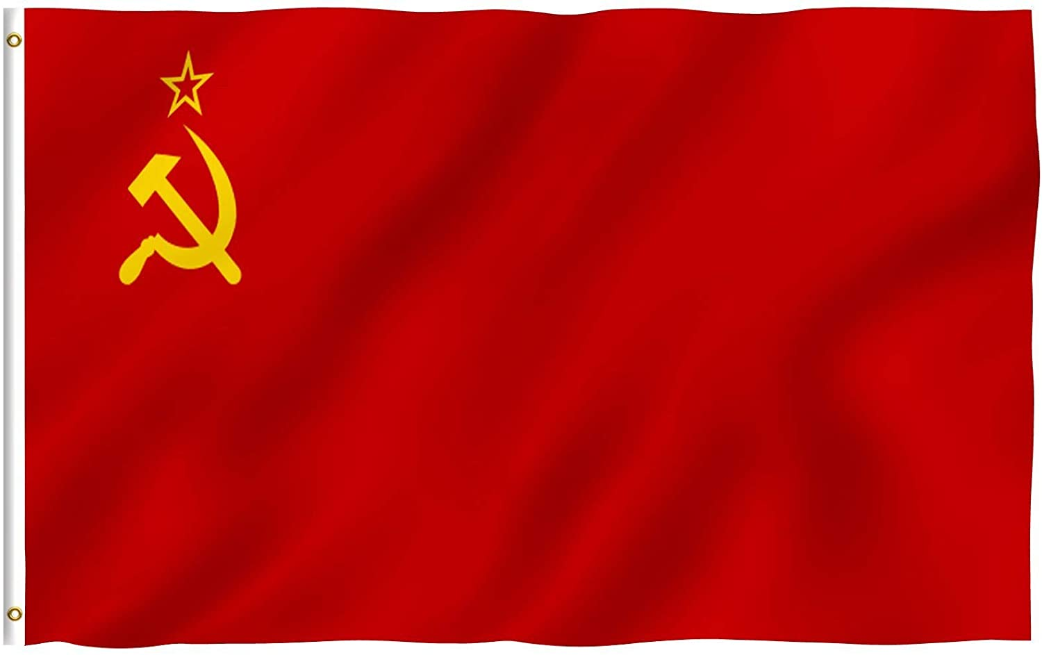
Rise of Communism: Russian Revolution (1917-1923)
Russia had to pull out of World War 1 due to it’s country going through a civil war.
Many Russian’s were tired of the war and wanted out.
They were tired of dealing with having a monarchy (king or Czar) in charge
The Russian Revolution was the first time a Communist government was created
Communist leaders promised to give land to poor and share all wealth (Unfortunately, all promises were not kept)
They gave power to a dictator (1 person in charge)
Russia becomes the Soviet Union.

Slide 5
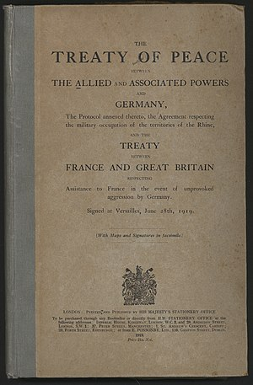
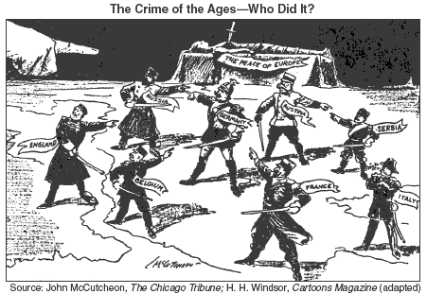
Treaty of Versailles: Who is to blame?
World War I lasted four bloody years. Nearly 50 million people would lose their lives and almost all countries were left with millions of dollars in debt and destruction.
30 countries were involved in the war but only 1 country would be blamed in the end:
GERMANY
The Treaty of Versailles was the agreement that ended World War I.
It placed full responsibly of the war on Germany (who was one of the strongest nations economically and military wise, before the war)
Would latter be considered a cause for the rise of Nazism and the Second World War

Slide 6
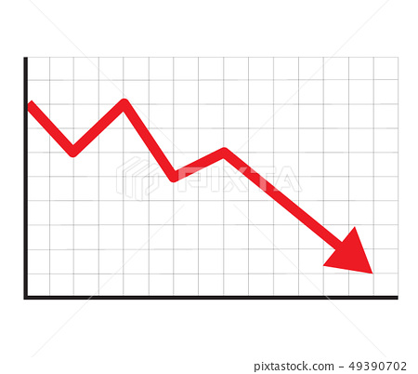
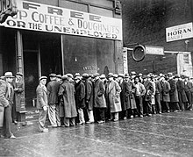
Worldwide Economic Depression
Most countries involved in World War I spent what money they had on the war efforts. This left many countries economies in shambles.
Destructions of towns, homes and businesses prevent people from getting back to their normal lives and governments did not have money to rebuild.
Unemployment rates increased. Many people were without a jobs and could not pay for the most basic necessities.
Countries tried to create more money but in doing so created inflation (your have more money but the value goes down) Imagine spending $1,000 on a loaf of bread
Many farms were destroyed during the war so food shortages were common.

Slide 7
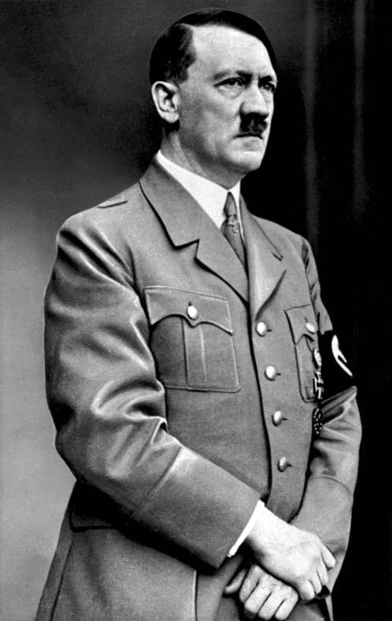
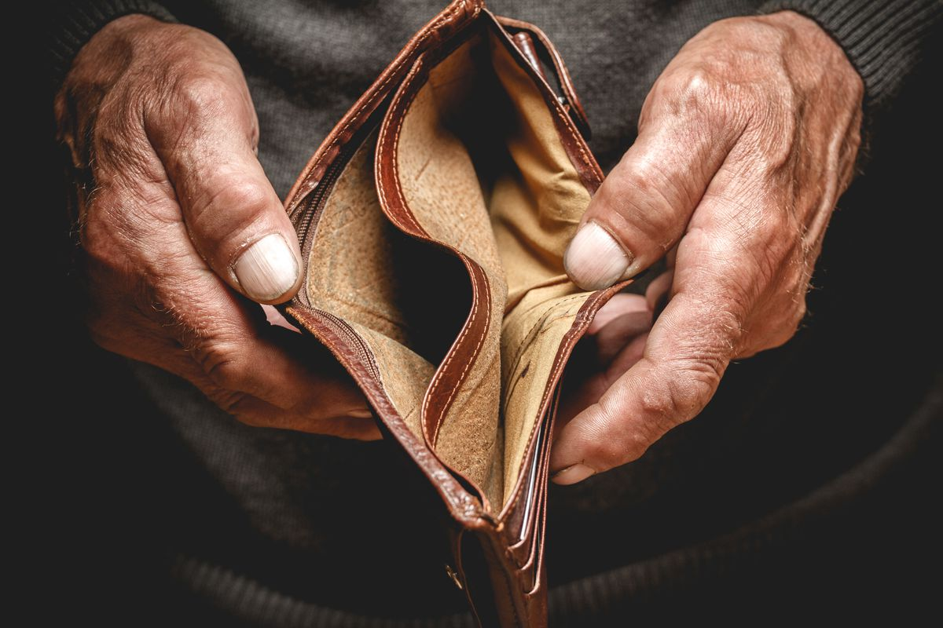
Rise of Nazism
Humiliated in front of the world, Germans resented the Treaty of Versailles.
People became upset with their leaders for agreeing to the terms and wanted leaders who defend and stick up Germany.
- Germans felt the Treaty of Versailles was unfair.
Citizens started to give power to Dictators (Ex. Adolf Hitler)
A dictator is 1 person who controls the entire government and military
Due to the Worldwide Economic Depression, people were without food and jobs; dictators offered solutions to these problems
Leaders start to blame others for losing World War I

Slide 8
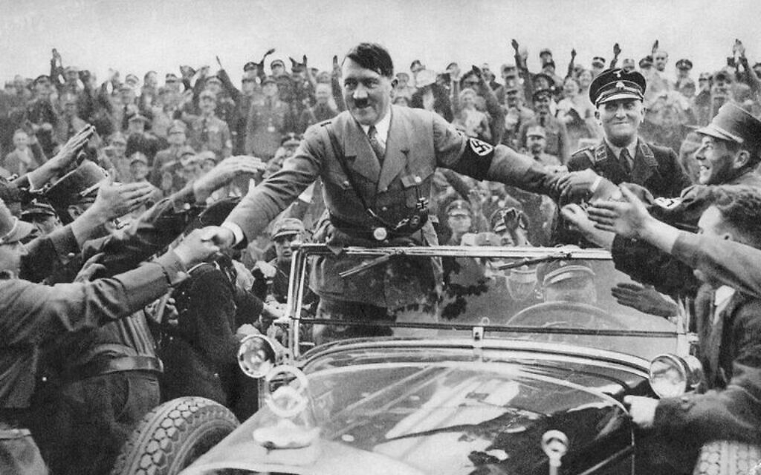
Closing: Checking for Understanding
What were the four events that occurred after World War 1 in Europe?
:

