Slide 1
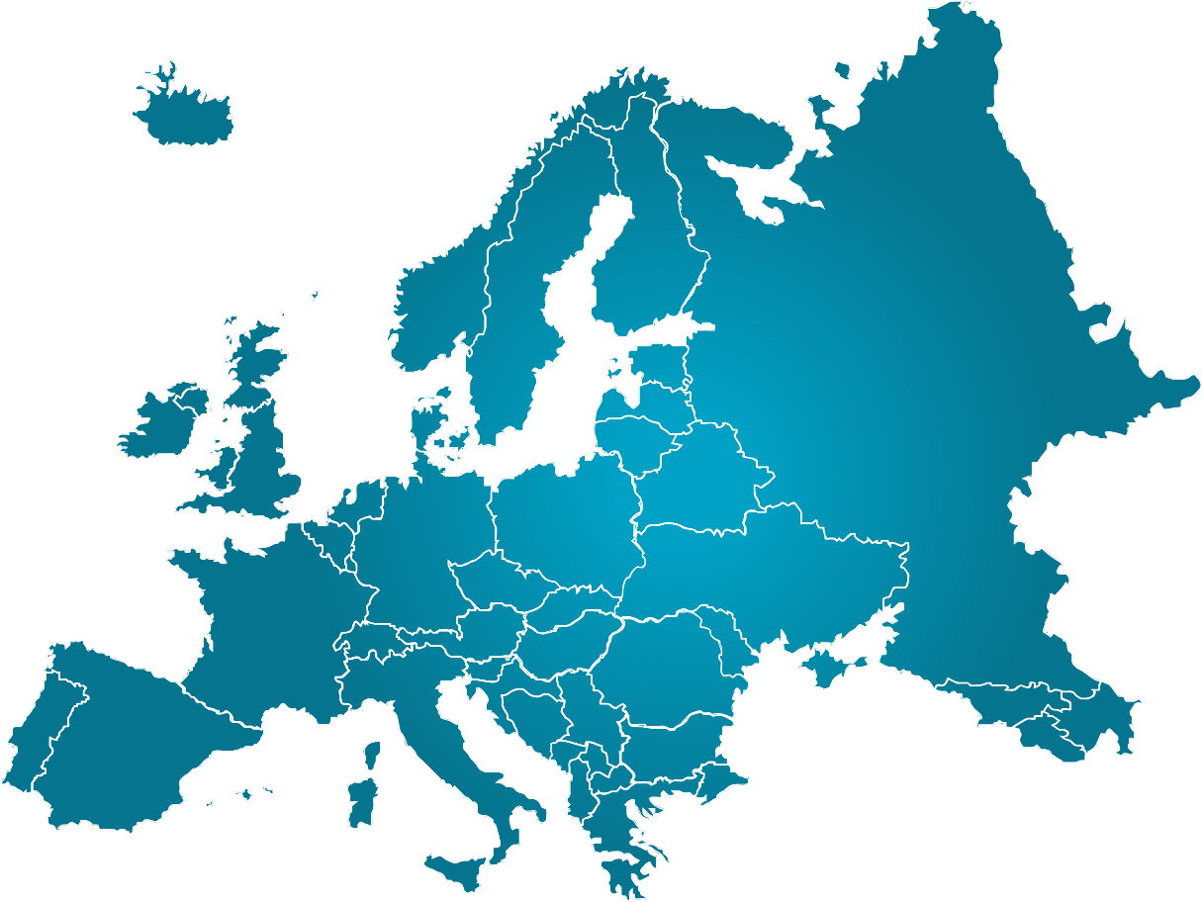
Europe
Map Analysis

Slide 2
Map Analysis
Examining the impact of climate, population density, and location of natural resources on various countries in Europe.
* See Brainpop Humans and the Environment for explanation of theme.

Slide 3
Climate
Definition:
the average course or condition of the weather at a place usually over a period of years as exhibited by temperature, wind velocity, and precipitation
Not to mistake with weather, which is more about what is happening that day or specific time.
*See Brainpop on Climate Types and Weather for additional information.

Slide 4
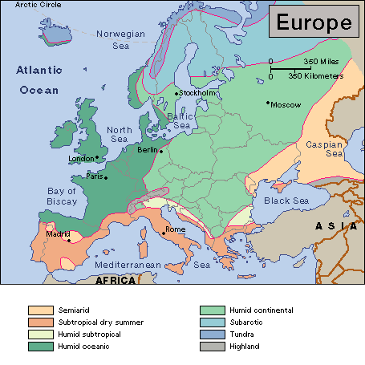

Slide 5
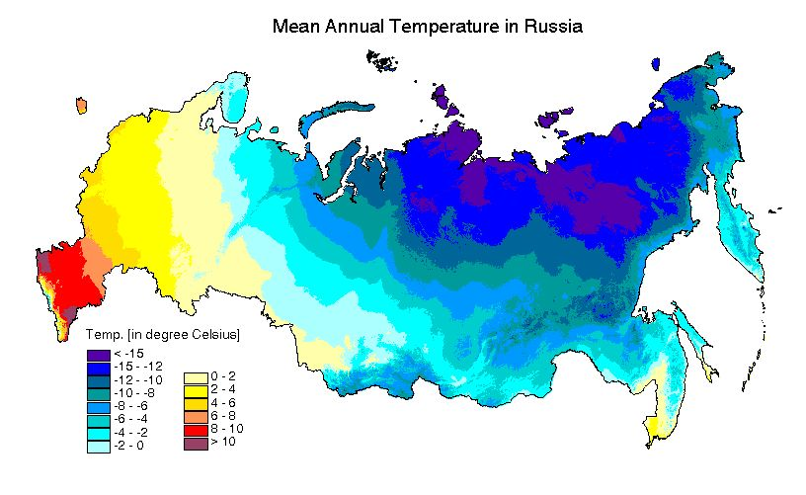

Slide 6
Population Density
the number of people living in each unit of area (such as a square mile)
* See Brainpop Population Growth for additional understanding of populations.

Slide 8
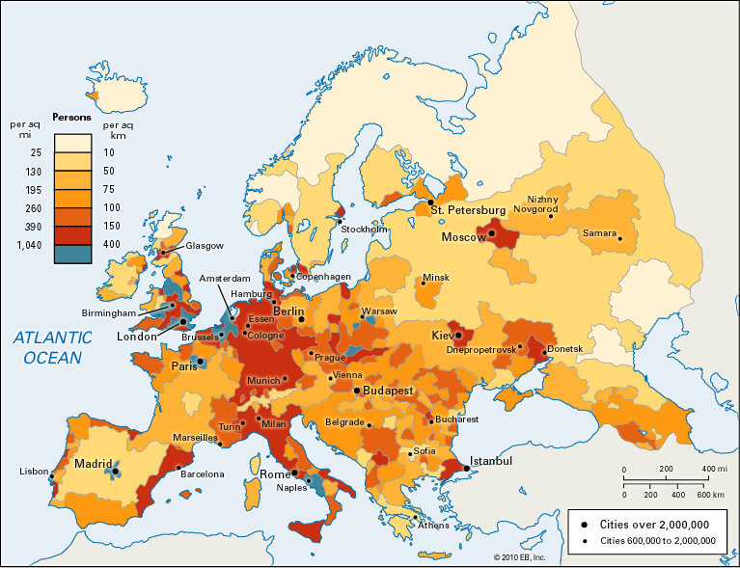

Slide 9
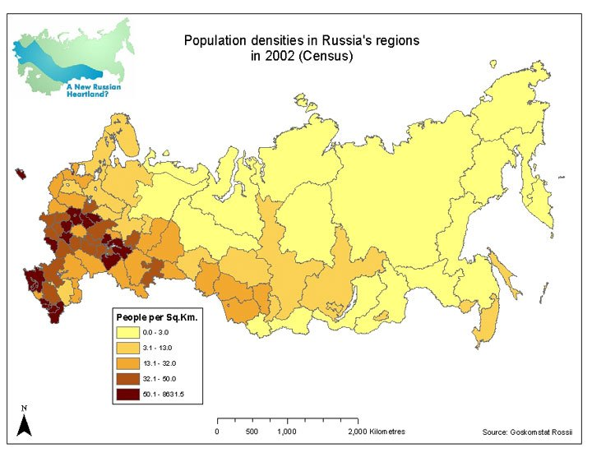

Slide 10
Location of Natural Resources
The relationship between where the natural resources of a country are located and where the population lives.
* See Brainpop Natural Resources for more clarification of different types.
Resource map example for all of Europe on Page 87 old atlas,

Slide 11
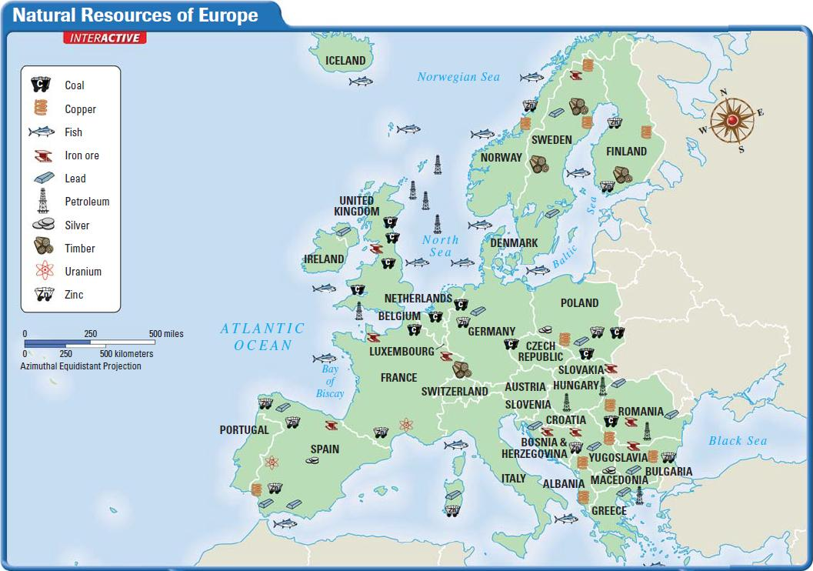

Slide 12
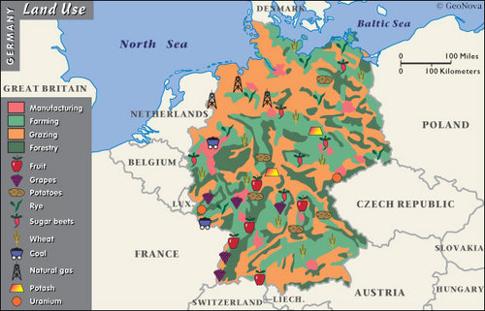

Slide 13
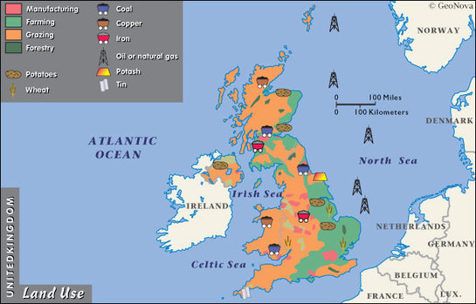

Slide 14
