Slide 6
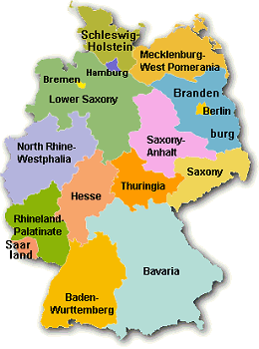

Slide 9
https://www.georgiastandards.org/Frameworks/GSO%20Frameworks%20Support%20Docs/SS_Instructional_Guide_MS-1-Jan%2009.pdf
http://www.euintheus.org/
http://europa.eu/youth/archive/new.cfm?nid=15625&sid=0&l_id=en

